Slide 1
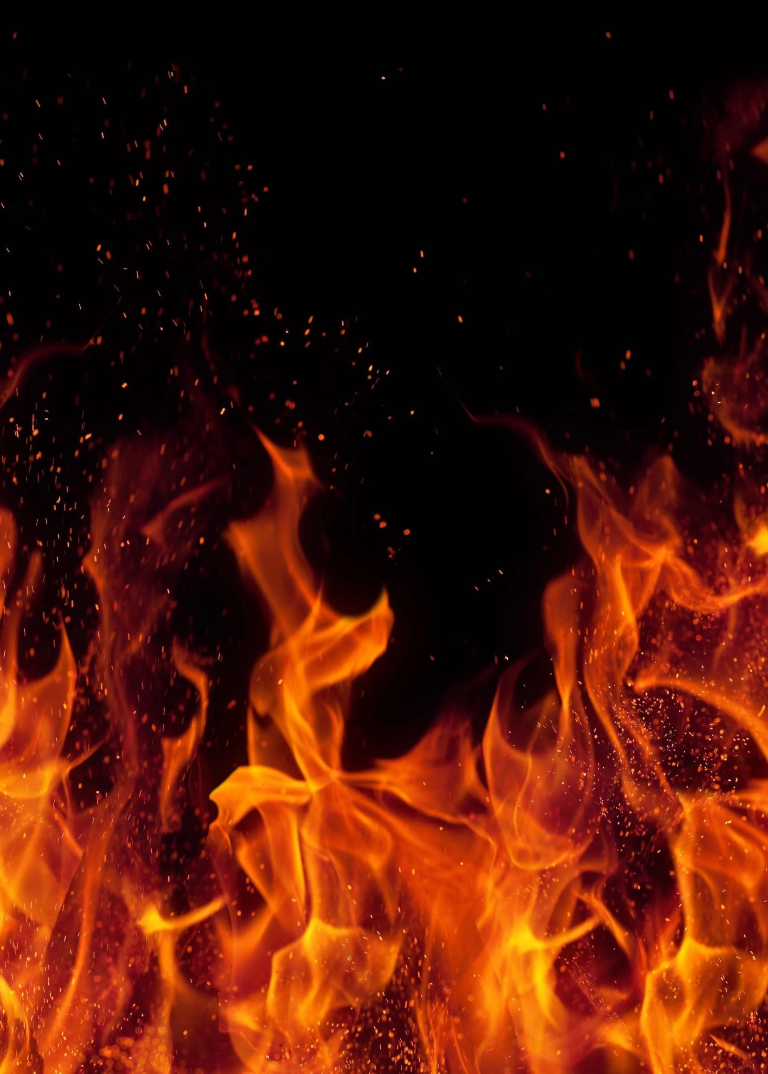








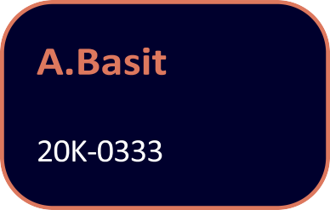

Slide 2



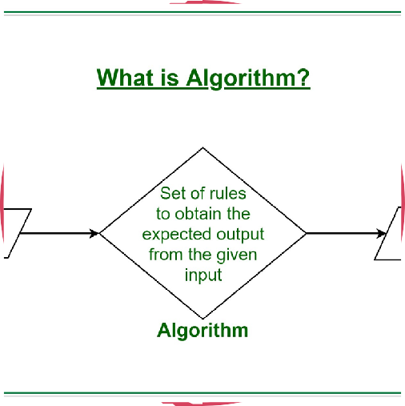
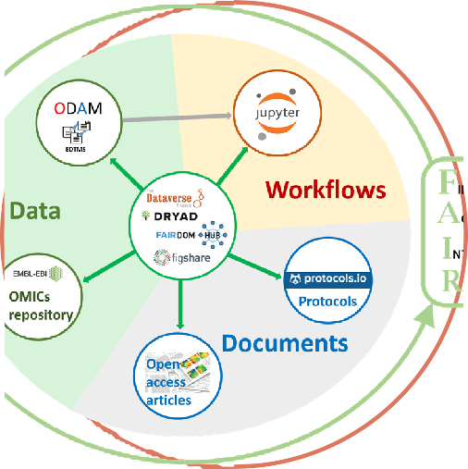











time.

Slide 3





















Slide 4

















Slide 5



















chance to spread.

Slide 6






















Slide 7






























altogether.

